Slide 1
1: Why TBLT?
TBLT: From Theory to Practice
Geoff Jordan

Slide 2
TBLT overcomes limitations of the current standard approach to LT
Synthetic syllabuses & methods which focus on studying the L2 as an object (e.g. coursebooks)
Analytic syllabuses are an alternative. Focus on meaning (e.g. Immersion courses). But limited.
TBLT = a viable alternative to synthetic syllabuses. It provides an analytic syllabus + ´focus on form`
A question of efficacy.

Slide 3
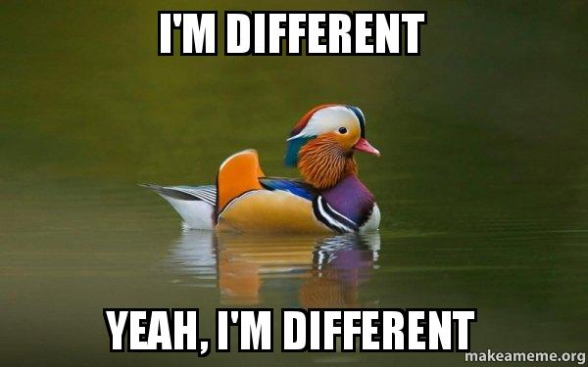
Preamble: learning an L2 is different
Special nature of language learning: not just knowing about the language, but also how to use it.
Declarative and procedural knowledge.
Grammar-translation & Situational Approach -> knowledge about L2 but not the ability to use it.
CLT was the answer, but weakened by arrival of coursebooks.

Slide 4
Synthetic Syllabuses
A synthetic approach focuses on knowing ‘about’ the language - on the formal aspects of the L2.
The L2 is divided up into its constituent parts and taught bit by bit. Grammar is the usual main building block. Start with “simple” parts and progress to more “complex”.
Learner’s job is to synthesise the items.
Declarative knowledge imparted first, then practice transforms it into procedural knowledge.
Syllabus = series of units where language items are selected, seeded into texts, contextualized, and then practised.
75% of classroom time dedicated to talking about & studying the language.

Slide 5
An Example: Outcomes Intermediate Unit 2
Items:
Vocab: feelings
Grammar: be/feel/look/seem/sound + adj.; ing vs ed adjs; present tenses
Lexical chunks: Response expressions; excuses
Pronunciation: Rising & falling stress
Skills practice:
Reading: 3 small texts
Listening: 4 short texts
Writing: 4 short exercises
Speaking: 4 guided activities

Slide 6
False assumptions of a Synthetic Syllabus
Declarative knowledge leads to procedural knowledge.
SLA is a process of mastering, 1 by 1, a sequence of items (e.g., grammar structures)
Learners learn what they’re taught, when they’re taught it.
All these assumptions are falsified by robust findings from SLA research.

Slide 7
“Producing English sentences with target-like negation, for example, requires control of word order, tense, and auxiliaries, in addition to knowing where the negator is placed. Learners cannot produce even simple utterances like ‘John didn’t buy the car’ accurately without all of those. It is not surprising, therefore, that Interlanguage development of individual structures has very rarely been found to be sudden, categorical, or linear, with learners achieving native-like ability with structures one at a time, while making no progress with others. Interlanguage development just does not work like that. Accuracy in a given grammatical domain typically progresses in a zigzag fashion, with backsliding, U-shaped behavior, mis –suppliance of target forms, flooding and bleeding of a grammatical domain (Huebner 1983), and considerable synchronic variation, volatility (Long 2003a), and diachronic variation.”
Long (2015:26)

Slide 8
Interlanguage development
Selinker (1972): Learners develop own mental grammar with internal principles.
Interlanguages are a slow movement towards closer approximations of L2
It’s autonomous, organised and learned implicitly.
Developmental stages:
Morpheme studies; 4 stages of negation; 6 stages of rel. clauses; Q-formation in German
Ls slowly master the grammar in roughly the same manner/order, which is impervious to instruction
Teaching affects rate not route

Slide 9
Analytic Syllabuses
Starts with the learner and learning processes.
Exposure to samples of the L2, and engagement in meaningful target language production.
Learners analyze the input, and induce rules of grammar and use.
No linguistic syllabus. Grammar rules, drills, and error correction are seldom, if ever, employed. More attention is paid to message and pedagogy than to language.
Syllabus = spoken and written activities and texts, chosen for their content, interest value, and comprehensibility.
But danger of reaching plateau and then fossilization.

Slide 10
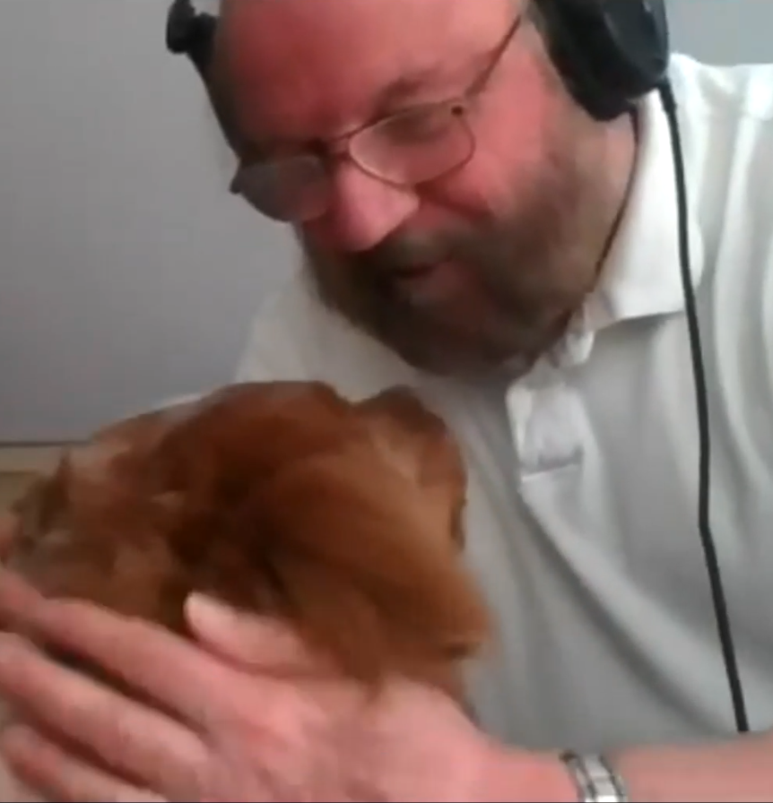
Long’s `Third Way´: Tasks + Focus on Form
Analytic syllabus (focus on meaning) + temporary shifts in attention to form, triggered by communication issues (compare FonFS with FonF.)
Needs Analysis to identify Target Tasks
Sequences of Pedagogic tasks = syllabus

Slide 11
Advantages of Long’s TBLT
Strong version of TBLT
Employs an analytic syllabus with a focus on form
Based on prime importance of implicit learning to develop procedural knowledge but acknowledges need for intentional, explicit learning of “fragile features”
Has psycholinguistic credibility

Slide 12
Advantages (cont.)
Embodies genuine learner-centeredness
Course content in TBLT is determined by learner needs and interests, not an externally imposed grammatical syllabus.
Attention to language form is reactive, i.e., responsive to the learner’s “internal syllabus.”

Slide 13
Other advantages
Learning by doing and collaborative learning are central
The classroom climate is egalitarian
Teacher as facilitator of learning (guide, not god)
Assessment is criterion-referenced, not norm-referenced

Slide 14
Rationale
1. Doughty (2003)
In sum, the findings of a pervasive implicit mode of learning, and the limited role of explicit learning in improving performance in complex control tasks, point to a default mode for SLA that is fundamentally implicit, and to the need to avoid declarative knowledge when designing L2 pedagogical procedures.
2. Nick Ellis (2005)
The bulk of language acquisition is implicit learning from usage. Most knowledge is tacit knowledge; most learning is implicit; the vast majority of our cognitive processing is unconscious.
3. Whong, Gil and Marsden (2014)
Implicit learning is more basic and more important than explicit learning, and superior. Access to implicit knowledge is automatic and fast, and is what underlies listening comprehension, spontaneous speech, and fluency. It is the result of deeper processing and is more durable as a result, and it obviates the need for explicit knowledge, freeing up attentional resources for a speaker to focus on message content.
4. ZhaoHong, H. and Nassaji, H. (2018)
On the relative effectiveness of explicit vs. implicit instruction, Kang et al. reported no significant difference in short-term effects but a significant difference in longer-term effects with implicit instruction outperforming explicit instruction.

Slide 15
References:
Bryfonski, L., & McKay, T. H. (2017). TBLT implementation and evaluation: A meta-analysis. Language Teaching Research.
Dellar, H. and Walkley, A. (2016) Teaching Lexically. Delta.
Doughty, C. (2003) Instructed SLA. In Doughty, C. & Long, M. Handbook of SLA, pp 256 – 310. New York, Blackwell.
Long, M. (2015) Second Language Acquisition and Task-Based Language Teaching. Oxford, Wiley.
Selinker, L. (1972) Interlanguage International Review of Applied Linguistics in Language Teaching, 10, 4, 209-232.
Whong, M., Gil, K.H. and Marsden, H., (2014). Beyond paradigm: The ‘what’ and the ‘how’ of classroom research. Second Language Research, 30(4), pp.551-568.
ZhaoHong, H. and Nassaji, H. (2018) Introduction: A snapshot of thirty-five years of instructed second language acquisition. Language Teaching Research, in press.

