Slide 1
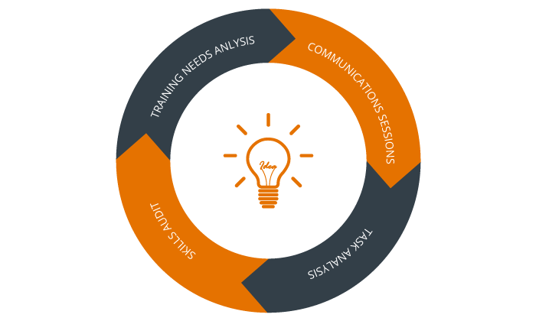
2019 Barcelona
From needs analysis
to task design
Roger Gilabert
Thanks to GRAL at the University of Barcelona, Generalitat de Catalunya (2014 SGR 1089).

Slide 2
Where I come from

Slide 3
Where I come from

Slide 4
outline
Part One
What we learned from NA
Part Two
How we went from NA to task design
Part Three
Unresolved issues and future work

Slide 5
P1
What we learned from NA
Part One

Slide 6
Syllabus design
Pedagogic design
What should units look like?
Need Analysis
What to teach
Unit selection, grading, and sequencing
In what order?
Methodological implementation
How to teach them
Evaluation
How to measure progress
Program assessment
Does the approach work?

Slide 7
Syllabus design
Need Analysis
What to teach

Slide 8
Triangulation
of methods and sources in a task-based NA
F-to-F interviews
Domain experts
TASKS
Company
representatives
Other sources
Task performance Observations
Online surveys

Slide 9
What we learned
Very precise task descriptions: context, goals, steps, expected outcomes, interconnectedness of tasks
Language more interesting and complex when in context (target discourse)
Information about cognitive complexity: reasoning demands, number of elements, here-and-now/there-and-then...
Information about performance standards
The functioning of the ‘discourse community’
Notes:
9

Slide 10
Tasks organized by frequency | Tasks organized by need for training
1- Translate information from Eng to Cat/Spa 2- To ask for information from a source or institution via e-mail 3- Obtain info from information web sites 4- Read official organizations web sites 5- Read magazines 6- Read press releases 7- Provide information about own institution via e-mail 8- Travel to English-speaking countries 9- Meet people in conferences and industry events … 18- Entertain visitors | 1- Translate information from Eng to Cat/Spa 7- Provide information about own institution via e-mail 12- Interview sources face-to-face (without interpreter) 2- To ask for information from a source or institution via e-mail 8- Travel to English-speaking countries 18- Entertain visitors 9- Meet people in conferences and industry events … 13- Attend and take notes at a press conference 15- Meals with sources (socializing)

Slide 11
tasks
From NA to task design
How can we go from NA to task design?
However, several empirical issues remain unresolved: (1) how the information obtained in NA transfers to the actual task design, (2) how the information about the variables
contributing to the task’s intrinsic complexity, and the users’ perception of difficulty, can be used to manipulate such features in instructionally sound ways during
pedagogic task design, and (3) how task information can be used for sequencing and grading pedagogic tasks.
(Malicka et al. 2019)

Slide 12
P2
How we went from NA to task design
Part Two

Slide 13
Syllabus design
Pedagogic design
What should units look like?
Unit selection, grading, and sequencing
In what order?

Slide 16
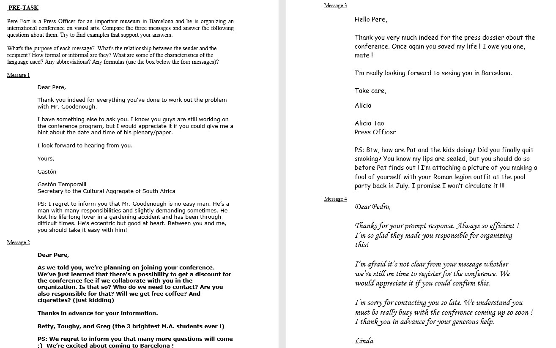
Notes:
During reading rapid eye movements are made from one point to another from left to right and back as well.
In between these movements, the eyes become stable for as long as needed to recognize a word: FIXATION
FIXATION DURATION is believed to indicate the duration of cognitive processing of the material located at fixation
Function, frequent, highly predictable words ar often skipped.

Slide 17
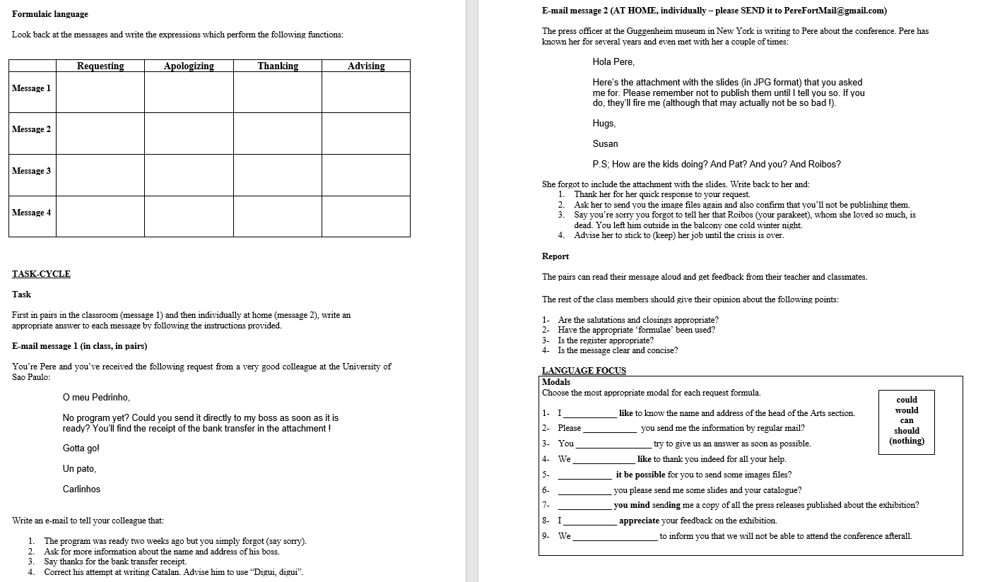
Notes:
During reading rapid eye movements are made from one point to another from left to right and back as well.
In between these movements, the eyes become stable for as long as needed to recognize a word: FIXATION
FIXATION DURATION is believed to indicate the duration of cognitive processing of the material located at fixation
Function, frequent, highly predictable words ar often skipped.

Slide 18
Notes:
During reading rapid eye movements are made from one point to another from left to right and back as well.
In between these movements, the eyes become stable for as long as needed to recognize a word: FIXATION
FIXATION DURATION is believed to indicate the duration of cognitive processing of the material located at fixation
Function, frequent, highly predictable words ar often skipped.

Slide 19
Syllabus design
Pedagogic design
What should units look like?
Unit selection, grading, and sequencing
In what order?

Slide 20
 | Simple | Simple | Complex | + Complex
+/- FAMILIARITY or +/- EQUAL STATUS | Familiarity with interlocutor/same status (colleague) | Less familiarity/high status (e.g. boss) | Unfamiliar/ high status (unknown person in an institution) | Very unfamiliar/ very high status (a personality)
+/- CAUSAL REASONING | Low reasoning demands (simple info transfer and independent instructions) (e.g. ask for and offer info) | Moderately low reasoning demands (info transfer, minor reasoning and independent instructions) (e.g. ask for something in an unfavorable situation) | High reasoning demands (complex reasoning and interconnected instructions) (e.g. in an unfavorable situation, try to persuade by providing convincing reasons) | Very high reasoning demands (highly complex reasoning and interconnected instructions) (e.g. try to justify a major mistake and persuade interlocutor to still help you)
+/- INTENTIONAL REASONING | Explicit message (e.g. straightforward) | Less explicit message (e.g. some irony) | Implicit message (e.g. irony and an implicit threat) | Very implicit message (e.g. a hard-to-figure out intention)
+/- ELEMENTS | Very few instructions | Few Instructions | Many instructions | A lot of instructions
+/- FREQUENCY OF INPUT | Frequent/known input (e.g. thanks for) | Less frequent or known input | Infrequent/unknown input | Very infrequent/unknown input

Slide 21
P3
Unresolved issues
Part Three

Slide 22
From NA to task design
What are some unresolved issues
Actual tasks?
Task prototypes?
How much intervention?
Sequencing criteria?
Task repetition?

Slide 23
Thank you
Gràcies
Gracias
Roger Gilabert
rogergilabert@ub.edu

