Slide 1
Complexity in the design and sequencing of pedagogic tasks
Mike Long
University of Maryland

Slide 2
How we got here: From TTs to TTTs for trainee airline flight attendants
TTs: Serve breakfast, lunch, dinner, drinks, snacks => TTT: Serve food and beverages
TTs: Check life vests, seat belts, oxygen cylinders => TTT: Check safety equipment
TTs: Check overhead bins, luggage stored under seats, passengers in assigned seats => TTT: Prepare for takeoff

Slide 3
Basic principles for designing and sequencing PTs
Simplify the task, not the language
Build schema if necessary
Input-based before production-based PTs
Parts before whole
Use FT adjustments (redundancy, input elaboration, slow pace, intentional pausing, repetition, etc.) initially. Then,
Gradually remove interactional crutches

Slide 4
From TTTs to PTs
TTT: Serve food and beverages
PT1: “The real thing” – Trainee FAs watch video clips of real FAs serving food and beverages to passengers during flights

Slide 5
PT2: Trainees hear 100+ utterances and identify corresponding picture between two choices (‘Would you like the fish or the lassagne?’ ‘Would you like tea or coffee?’ ‘Would you like a newspaper, a pillow,
something to drink, some ice with your drink, some water, etc.?’

Slide 6
PT3: Trainees hear 100+ utterances and identify corresponding pictures among multiple possibilities

Slide 7
Note: Students’ focus will be recognizing lexical items that will tell them which is the correct picture. ‘Would you like’ X? Will be learned incidentally from the massive input (200+ models, so far). Adults can and do learn incidentally, from spoken, not just written, input.

Slide 8
See, e.g., this recent statistical meta-analysis on incidental vocabulary learning:
De Vos, J. F., H. Schriefers, M.G. Nivard & K. Lemhofer (2018). A meta-analysis and meta-regression of incidental second language word learning from spoken input. Language Learning 68, 4, 906-941.

Slide 9
PT4: Trainees see pictures of items and offer accordingly, first with models, then without
PT5: They listen to and observe complete FA - passenger exchanges, with multiple items
PT6: They take FA turns in exchanges

Slide 10
PT7: They observe FA - passenger exchanges, with some items unavailable (‘I’m sorry. We’re out of X.’ ‘Would you like Y, instead?’ ‘I can offer you Y, instead.’)
PT8: They take FA turns in such exchanges

Slide 11
PT9: Exit task – Full simulation/role play
Trainee FAs are scored pass/fail according to whether they provide the correct items to passengers, i.e., using objective, behavioral outcomes, and probably also according to their use of an appropriate level of politeness, use of apology formulae, etc.

Slide 12
Simply the task, elaborate the language
Traffic accident: Four input possibilities
1. Genuine
The only witness just caught a glimpse of the driver as he fled the scene, so she could only provide the police with a rough description.

Slide 13
2. Simplified
A woman was the only person who saw the accident. She saw the driver for only a moment. The driver did not stop. He immediately drove away fast. The woman could only tell the police a little about him.

Slide 14
3. Elaborated
The only person who saw the accident, the only witness, was a woman. She only caught a glimpse of the driver, just saw him for a moment, because he fled the scene, driving away fast without stopping, so she could only provide the police with a rough description of him, not an accurate one.

Slide 15
4. Modified elaborated
The only person who saw the accident, the only witness, was a woman. She only caught a glimpse of the driver, just saw him for a moment, because he fled the scene, driving away fast without stopping. As a result, she could only provide the police with a rough description of him, not an accurate one.

Slide 16
The SSARC model (Robinson, 2010)
Sequence resource-directing before resource-dispersing PTs
Malicka, A. (2018). The role of task sequencing in fluency, accuracy, and complexity: Investigating the SSARC model of pedagogic task sequencing. Language Teaching Research https://doi.org/10.1177/1362168818813668

Slide 17
Resource-directing features
More elements/steps, greater item similarity, heavier reasoning demands, there-and-then (displaced time and space/context-disembedded), etc. => increase cognitive task demands => learners attend more closely to linguistic features (e.g., use more modifiers or RCs to differentiate items) => greater accuracy and complexity

Slide 18
Resource dispersing/depleting features
+/- planning time, task familiarity/prior knowledge, +/- single task, +/- task structure => learners divide their attentional resources to multi-task, e.g., taking notes while listening to a lecture or talking on the phone. That does not affect level of attention to language, but does affect procedural demands and automaticity => greater fluency, but lower accuracy and complexity

Slide 19
Malicka & Sasayama (2017) Resource-dispersing variables
Statistical meta-analysis findings:
More robust patterns for resource-dispersing variables
Simpler tasks in resource-dispersing terms (especially + planning time) had positive effects on all CALF variables, especially complexity and accuracy (less so, lexis and fluency)

Slide 20
Malicka & Sasayama (2017) Resource-directing variables
3. There-and-then tasks produced greater syntactic complexity
4. More elements or heavier reasoning demands produced more varied lexis

Slide 21
5. Overall, findings for resource-directing variables were less clear, more variable
[I suspect that is at least in part due to the diverse ways complexity (and DVs?) have been operationalized.]

Slide 22
A practical problem
In principle, gradually increased complexity (task complexity, not linguistic complexity) offers a rational basis for sequencing PTs. But findings have been mixed, perhaps due to the variety of PTs and dizzying array of measures employed. And there is often an additional logistical problem:

Slide 23
The problem
Studies have found that both native and non-native speakers sometimes ignore added complexity in the second or third version of a task, e.g., in the form of more items or heavier reasoning demands, if the task can still be completed minimally satisfactorily that way
2

Slide 24
They may do so intentionally (path of least resistance) or unintentionally (additional elements go unnoticed). Regardless of the cause, such short-cuts work against the ultimate goal of the researcher, syllabus designer, materials writer, classroom teacher, and the learners themselves, which is to use task complexity as one means of driving SLA

Slide 25
Consider this example. The video clips are from a study by Jiyong Lee:
Lee, J. (2018). Task complexity, cognitive load, and L1 speech. Applied Linguistics.

Slide 26
Car accident VIDEO clips
3

Slide 27
LEAST COMPLEX
4

Slide 28
MID-COMPLEX
5

Slide 29
MOST COMPLEX
6

Slide 30
SYNTACTIC COMPLEXITY
7

Slide 31
TWO potential SOLUTIONS
1. Task closure
2. Feedback loops
8

Slide 32
1. TASK CLOSURE
Learners can be informed that a PT is (i) ‘open’, i.e., has many possible solutions, any of which is acceptable, or (ii) ‘closed’, i.e., has either a single correct solution or a very small, finite number of correct solutions
Theory predicts that closure is more likely to make learners perform a PT the way the designer intended, and (a testable hypothesis) do so while absorbing more new language from the input accompanying the task and/or using more accurate and/or more complex speech or writing. But research findings have been mixed, some even favoring open versions of tasks
9

Slide 33
2. FEEDBACK LOOPS
Feedback loops can be built into PTs to provide learners with positive and negative feedback on their progress after one or more sub-tasks. If it is considered useful, the loops can prevent them from continuing until they have performed a sub-task correctly
The first step is to show proof of concept with minimal pairs of PTs
10

Slide 34
1. Task closure
Geometric figures task
Illustrations from:
Montero, F. (2018). Effects of task complexity and task closure on the speech of L2 learners of Spanish. Qualifying Paper. Ph.D. in SLA Program, University of Maryland.

Slide 35
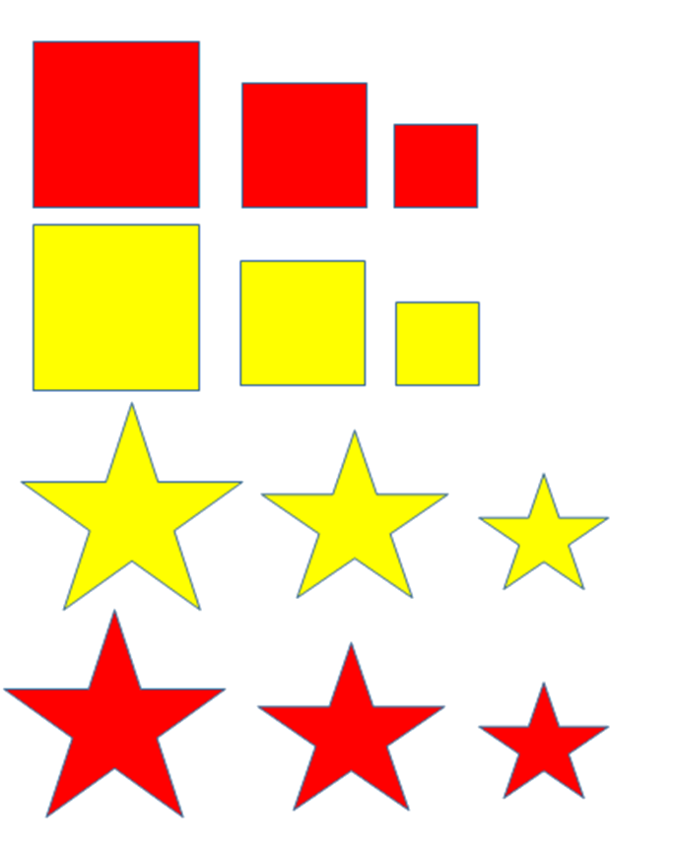
GEOMETRIC FIGURES (Simple, Open)
Students describe an arrangement of their own creation of (say) 12 geometric shapes so that other students (separated by a screen) can reproduce the arrangement without seeing it.
16

Slide 36
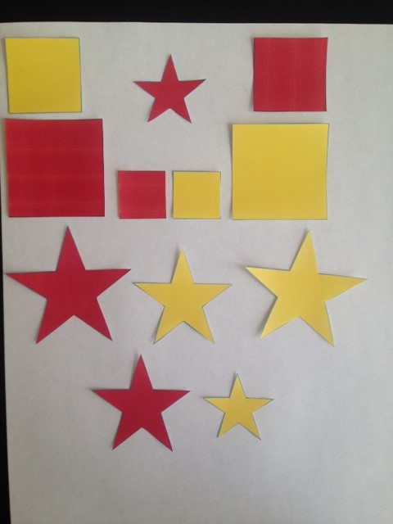
GEOMETRIC FIGURES (Simple, Closed)
Students describe an arrangement of the same 12 shapes, but this time fixed, created by a third party, shown in a picture the speaker is given.
17

Slide 37
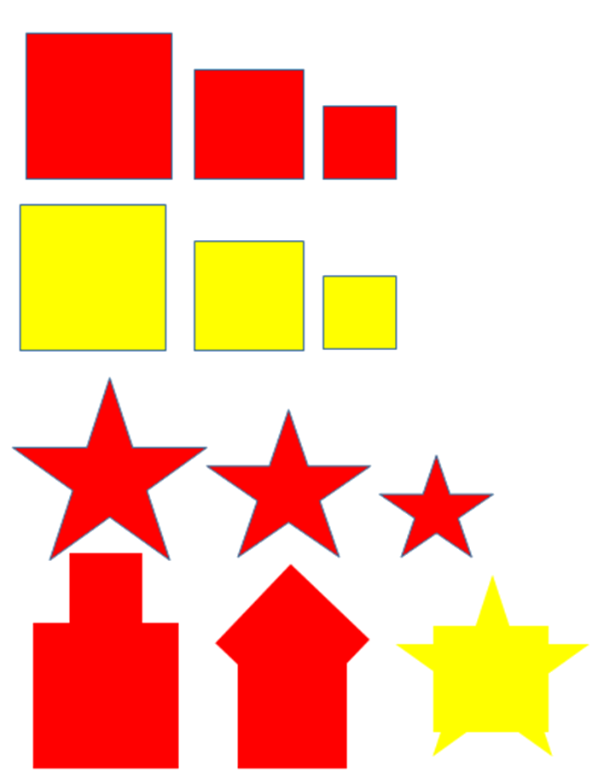
GEOMETRIC FIGURES (Complex, Open)
Holding the total number of shapes (12) constant, complexity is added to the open or closed versions by substituting three complex shapes for three simple ones (holding the overall total to 12), e.g., instead of a plain yellow square, a yellow square on top of a yellow star.
18

Slide 38
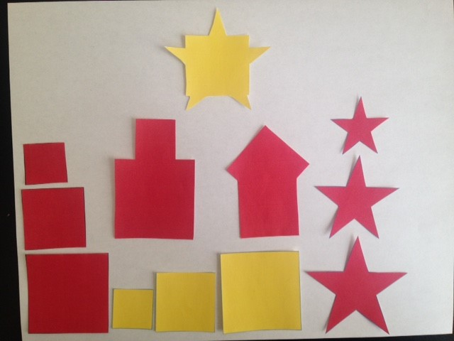
GEOMETRIC FIGURES (Complex, Closed)
Students describe an arrangement of the same 12 shapes, but this time fixed, created by a third party, shown in a picture the speaker is given.
19

Slide 39
1. Task closure
Seating arrangements task
(PTs designed by Mike Long, cue cards and visuals by Jiyong Lee)

Slide 40
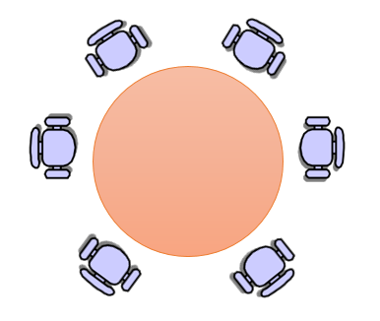
SEATING ARRANGEMENTS Simple, Open (6 - 0)
Six people are going to meet each other for the first time when they have dinner together in a Chinese restaurant. They will be seated at a round table. Their names, nationalities, occupations, political outlook, hobbies, and the languages they speak are listed below. They have some characteristics in common, but they differ in other ways. They can be seated in any way you choose. How will you seat them? Who will sit next to whom? You can make a drawing and write notes if it helps.
You have five minutes to plan your answer, and then a maximum of ten minutes to describe and explain your proposed seating arrangement. Remember, it will be a round table, so the first and last people on your list will be seated next to one another.
21

Slide 41
Complexity is added by increasing (i) the number of dinner guests and (ii) the number of constraints
4 - 6 - 8 people
0 -1 - 2 - 3 constraints

Slide 42
SEATING ARRANGEMENTS Complex, closed (6 - 3)
3 constraints: gender, politics, language
Six people are going to meet each other for the first time when they have dinner together in a Chinese restaurant. They will be seated at a round table. Their names, nationalities, occupations, political outlook, hobbies and the languages they speak are listed below. They have some characteristics in common, but they differ in other ways.
There are three rules:
No two men or two women can sit next to one another.
Left-wingers can be seated next to one another or next to political centrists, but not next to right-wingers. Right-wingers can sit next to one another or to centrists, but not to left-wingers.
People must be able to speak at least one of the languages of the person on each side of them.
There is only one arrangement that meets all the requirements. How will you seat them? Who will sit next to whom? You can make a drawing and write notes if it helps. You have five minutes to plan your answer, and then a maximum of ten minutes to describe and explain your proposed seating arrangement. Remember, it will be a round table, so the first and last people on your list will be seated next to one another.
22

Slide 43
DINNER GUESTS
John
American
Businessman
Very conservative
English & German
Golf, vintage cars
Pierre
French
Physician
Left-wing
French & Spanish
Walking, reading
Elke
German
Banker
Right-wing
German & Russian
Tennis, golf
Maria
Spanish
Journalist
Centrist
Spanish & English
Painting, movies
Heidi
Austrian
Lawyer
Centrist
German & Russian
Gardening, painting
Pablo
Mexican
Dentist
Centrist
Spanish & German
Walking, gardening
23

Slide 44
2. Feedback loops
Street directions
(cue cards and visuals by Jiyong Lee)

Slide 45
STREET DIRECTIONS (1)
Giving and following street directions
(open, with feedback loops)
From starting-points chosen by the speakers (teacher or students), hearers (other students) follow the speakers’ directions, in order to reach destinations also chosen by the speakers and unknown to the hearers, which the speakers are free to change along the way.
There are two potential sources of feedback, verbal or visual.
Verbal: After every two or three instructions, the speakers ask the hearers simple questions to see whether they are following correctly (e.g., Which street are you on now? What is the building on your left? Are you facing north, south, east or west?).
Visual: In the form of features built into the map, the hearers encounter obstacles of various kinds if they miss a turning or take a wrong one (cul-de-sacs, road closures, traffic accidents, one-way streets, roads blocked due to a building fire, etc.).
In each case, if there is a problem, either the hearers retrace their steps and try again or the speakers simply carry on to a different destination. On arrival, speakers and hearers say what the destination is (a number, 1-10, a letter, A – J, or a place, e.g., a museum, railway station, library, mosque, or hospital).
26

Slide 46
STREET DIRECTIONS (2)
Giving and following street directions
(closed, with feedback loops)
Given fixed starting-points, either 1-10, letters, A-J, or landmarks (‘You are here →’), hearers follow speakers’ directions to specific destinations, which are unknown to the hearers and fixed by the teacher or materials writer in advance.
There are two potential sources of feedback, verbal or visual.
Verbal: After every two or three instructions, the speakers ask the hearers simple questions to see whether they are following correctly (e.g., Which street are you on now? What is the building on your left? Are you facing north, south, east or west?).
Visual: If the hearers miss a turning or take a wrong one, they encounter obstacles of various kinds in the form of features built into the map (cul-de-sacs, road closures, traffic accidents, one-way streets, roads blocked due to a building fire, etc.).
In each case, if there is a problem, the hearers must retrace their steps to the last known correct position and try again. On arrival at the final destination, they must say what it is (a number, 1-10 or letter, A – J) or a place, e.g., a museum, railway station, library, mosque, or hospital).
27

Slide 47
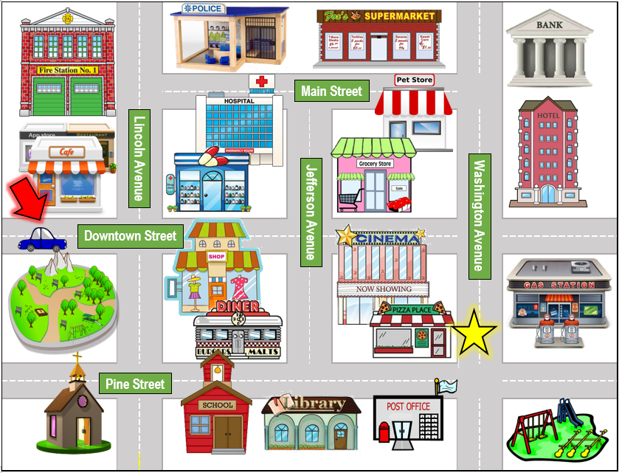
LEAST COMPLEX
28

Slide 48
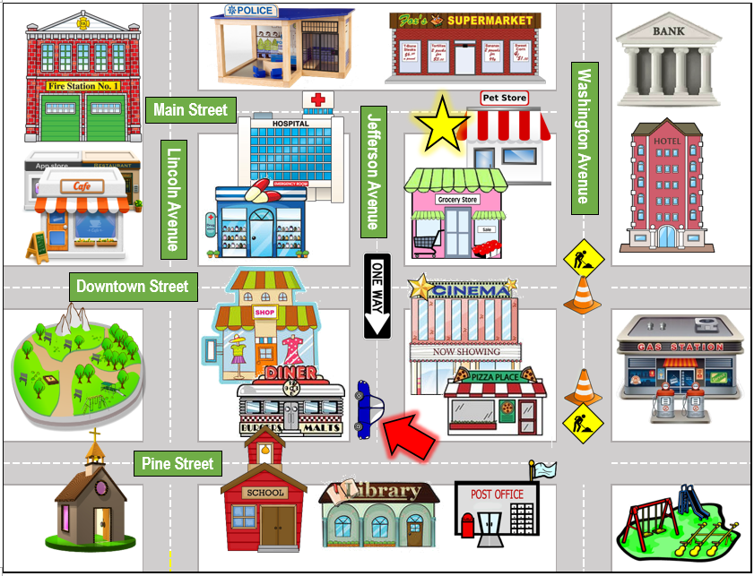
MID-COMPLEX
29

Slide 49
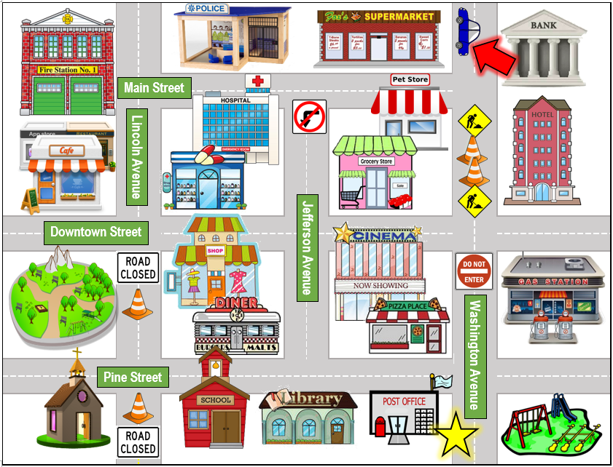
MOST COMPLEX
30

Slide 50
Clearly, a lot more research is needed
To be continued!

